Slide 1
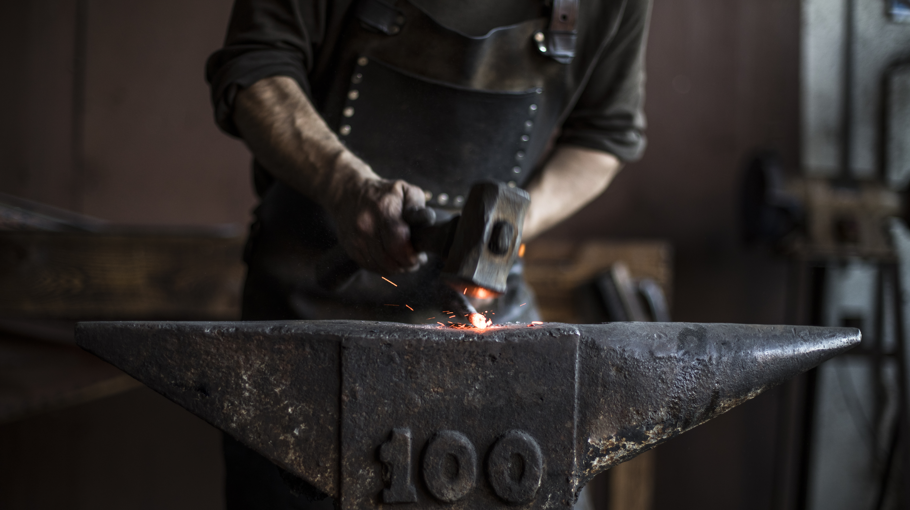
Process Design Flowsheet

Slide 2
Flowsheet Block
Flowsheet 1
Recycle reactant
H₂
Better separation
More DMO
More complicated
More purchase
Less energy usage
CO
MN
NO
Side products
REACTOR 1
SEPARATION 1
REACTOR 2
SEPARATION 2
2 distillation column
Ethylene Glycol
Flowsheet 2
H₂
Worse separation
Less DMO
Simpler
Less purchase
More energy usage
CO
MN
NO
Side products
REACTOR 1
SEPARATION 1
REACTOR 2
SEPARATION 2
Flash tank
Ethylene Glycol

Slide 3
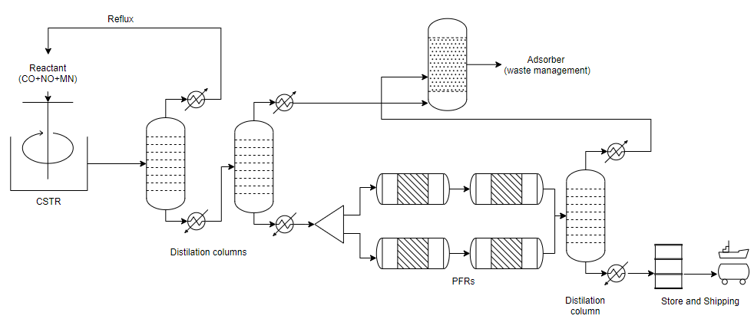
Process Flow Diagram Flowsheet 1
H2

Slide 4

Process Flow Diagram Flowsheet 2
H2

Slide 5
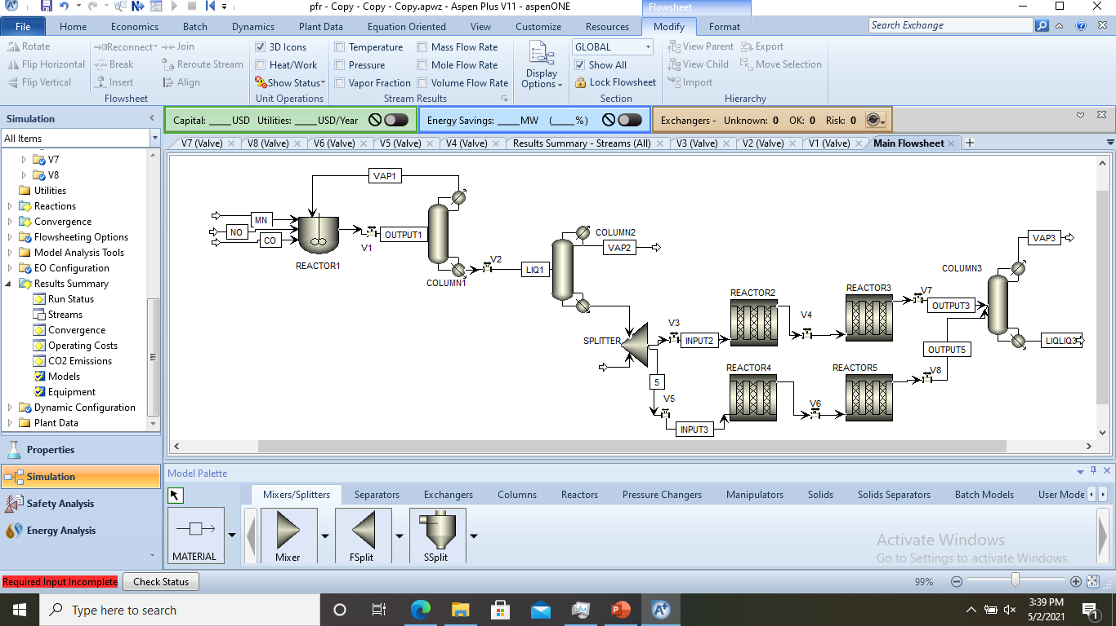
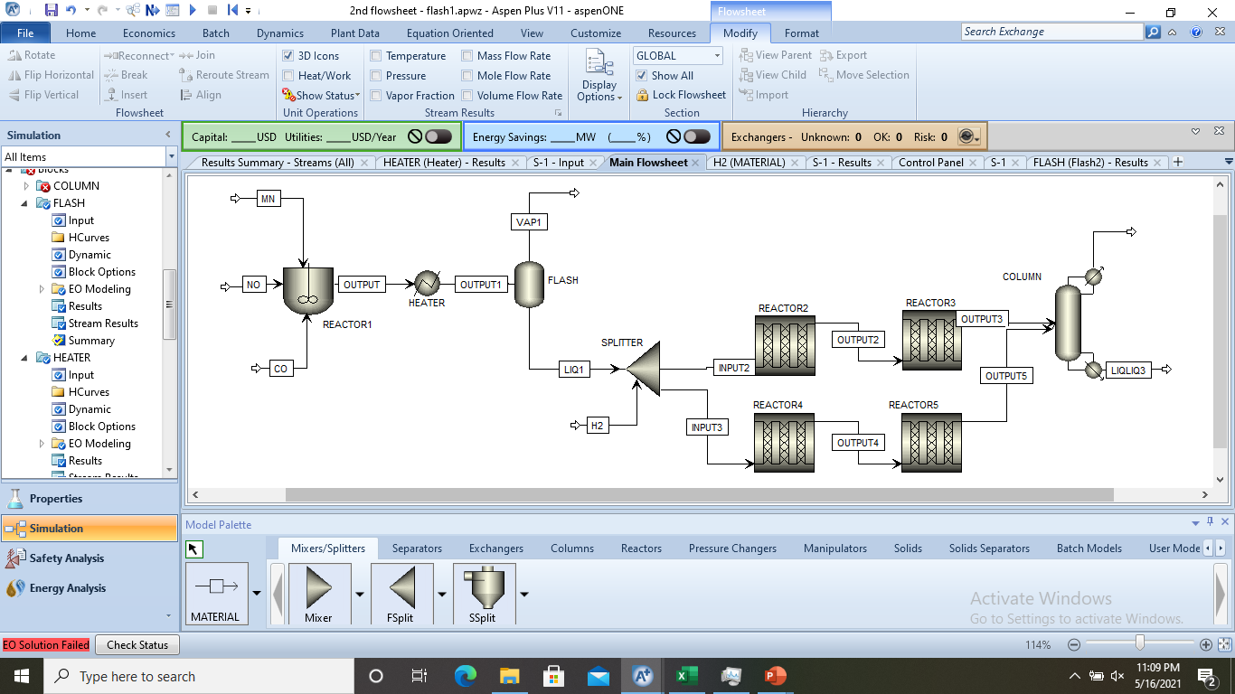
Reactor 1 : producing DMO
Flowsheet 1
-174.3℃, 5 bar
16294.5 kg/hr
100w% CO
Parameter
Mass Balance
 | In (kg/hr) | Out (kg/hr)
MN | 8000 | 21.91
NO | 1000 | 4922.62
CO | 22294.5 | 18632.75
DMO | - | 7717.22
8000 kg/hr MN
1000 kg/hr NO
6000 kg/hr CO
Temp : 129℃
Pressure : 5 bar
Duty: 4710.65 kW
Volume: 1597.86 L
Conversion = 1
Selectivity = 0.5
Reactor Yield = 1
129℃, 5 bar
31294.5 kg/hr
24.66w% DMO
59.54w% CO
15.73w% NO
0.07w% MN
Flowsheet 2
8150 kg/hr MN
100 kg/hr NO
3740 kg/hr CO
Parameter
Mass Balance
 | In (kg/hr) | Out (kg/hr)
MN | 8150 | 55.154
NO | 100 | 4079
CO | 3740 | 25.179
DMO | - | 7830.67
129℃, 5 bar
11990 kg/hr
65.31w% DMO
0.21w% CO
34.02w% NO
0.46w% MN
Temp : 129℃
Pressure : 5 bar
Duty: 12635.2 kW
Volume: 254.38 L
Conversion = 0.99
Selectivity = 0.5
Reactor Yield = 1

Slide 6
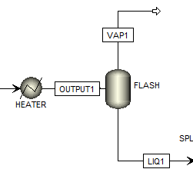
Separation 1: separating DMO
CO
Light key
NO
DMO
Heavy key
Flowsheet 1
Flowsheet 2
-174.3℃, 5 bar
16294.5 kg/hr
100w% CO
Condenser duty: -4175.38 kW
85℃, 1.15 bar
4192.18 kg/hr
7.92w% DMO
0.58w% CO
90.21w% NO
1.29w% MN
Condenser duty: 1236.95kW
-182.59℃, 1 bar
7164.68 kg/hr
32.64w% CO
67.36w% NO
129℃, 5 bar
31294.5 kg/hr
24.66w% DMO
59.54w% CO
15.73w% NO
0.07w% MN
129℃, 5 bar
11990 kg/hr
65.31w% DMO
0.21w% CO
34.02w% NO
0.46w% MN
-200.79 kW
vapor fraction (mole): 0.64
Reboiler duty:
-6031.5 kW
-157.49℃, 5 bar
15000.02 kg/hr
51.46w% DMO
15.59w% CO
32.82w% NO
0.14w% MN
137.513℃, 1 bar
7835.55 kg/hr
98.51w% DMO
0.26w% MN
1.23w% NO
-16119.2 kW
85℃, 1.15 bar
7797.82 kg/hr
96.16w% DMO
0.01w% CO
3.82w% NO
NTS: 16 (feed stream: 4)
RR (mole): 5
Reboiler duty:
2076.19kW
6
NTS: 21 (feed stream: 16)
RR (mole): 0.45
DMO separated: 7718.8 kg/hr (100%)
DMO separated: 7498.38 kg/hr (95.76%)

Slide 7
Reactor 2: producing EG
Flowsheet 1
Sensitivity Test
-858.92 kW
200℃, 16 bar
6 m, 100 tubes, 0.02 m diameter, 14 kg catalyst
-419.15 kW
241℃, 24 bar
6 m, 500 tubes, 0.02 m diameter, 923 kg catalyst
Split frac: 0.5
241℃, 24 bar
4201 kg/hr
4.68w% H2
50.18w% DMO
16.41w% MeOH
17.45w% MG
9.89w% EG
200℃, 16 bar
4201 kg/hr
6.71w% H2
90.98w% DMO
0.24w% MeOH
0.68w% MG
102.31℃, 1 bar
4201 kg/hr
6.74w% H2
91.87w% DMO
1.15w% NO

Slide 8
Reactor 2: producing EG
Flowsheet 2
Sensitivity Test
-755.05 kW
200℃, 16 bar
6 m, 100 tubes, 0.02 m diameter, 14 kg catalyst
-750.69 kW
244℃, 26 bar
6 m, 500 tubes, 0.02 m diameter, 923 kg catalyst
Split frac:0.5
244℃, 26 bar
4185.16 kg/hr
4.41w% H2
38.5w% DMO
19.29w% MeOH
23.70w% MG
10.52w% EG
81.71℃, 1.15 bar
4185.16 kg/hr
6.84w% H2
89.58w% DMO
3.56w% NO
200℃, 16 bar
4185.16 kg/hr
6.81w% H2
88.69w% DMO
0.24w% MeOH
0.68w% MG

Slide 9
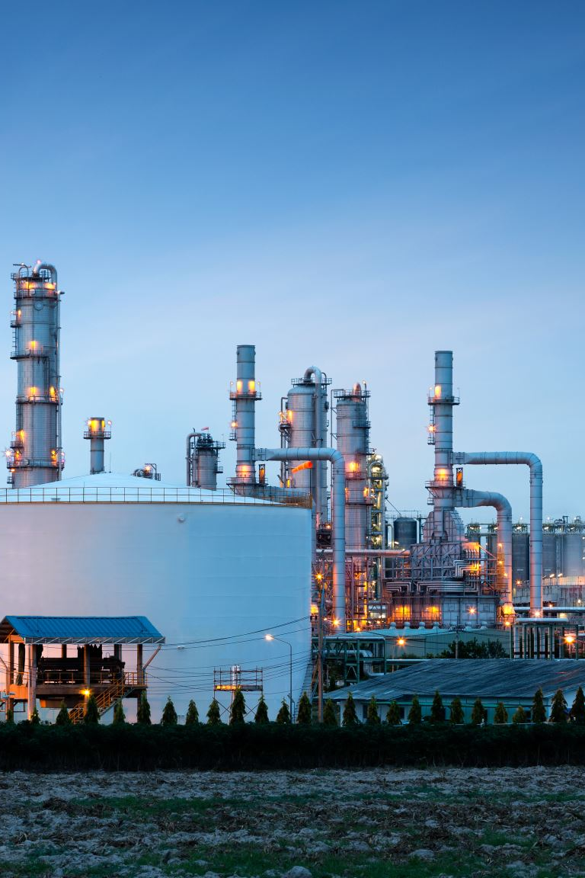

Reactor 2-Comparison
 | Flowsheet 1 | Flowaheet 2
Duty 1 (kW) | -858.92 | -755.05
Duty 2 (kW) | -415.15 | -750.69
EG produced (kg/hr) | 830.96 | 880.19
Conversion (DMO) | 0.45 | 0.57
Selectivity (DMO) | 0.45 | 0.39
Yield (DMO) | 0.45 | 0.39
Conversion (H2) | 0.31 | 0.35
Selectivity (H2) | 0.16 | 0.14
Yield (H2) | 0.31 | 0.28

Slide 10
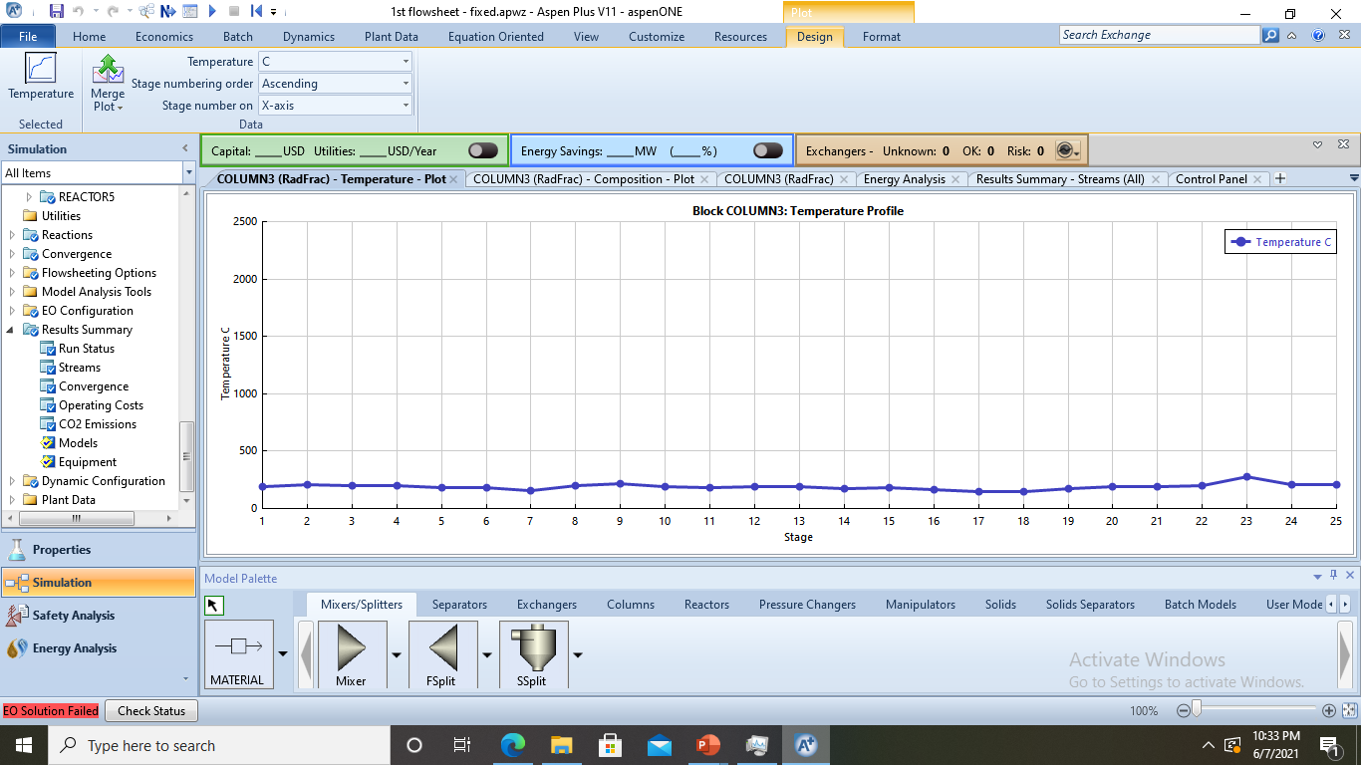
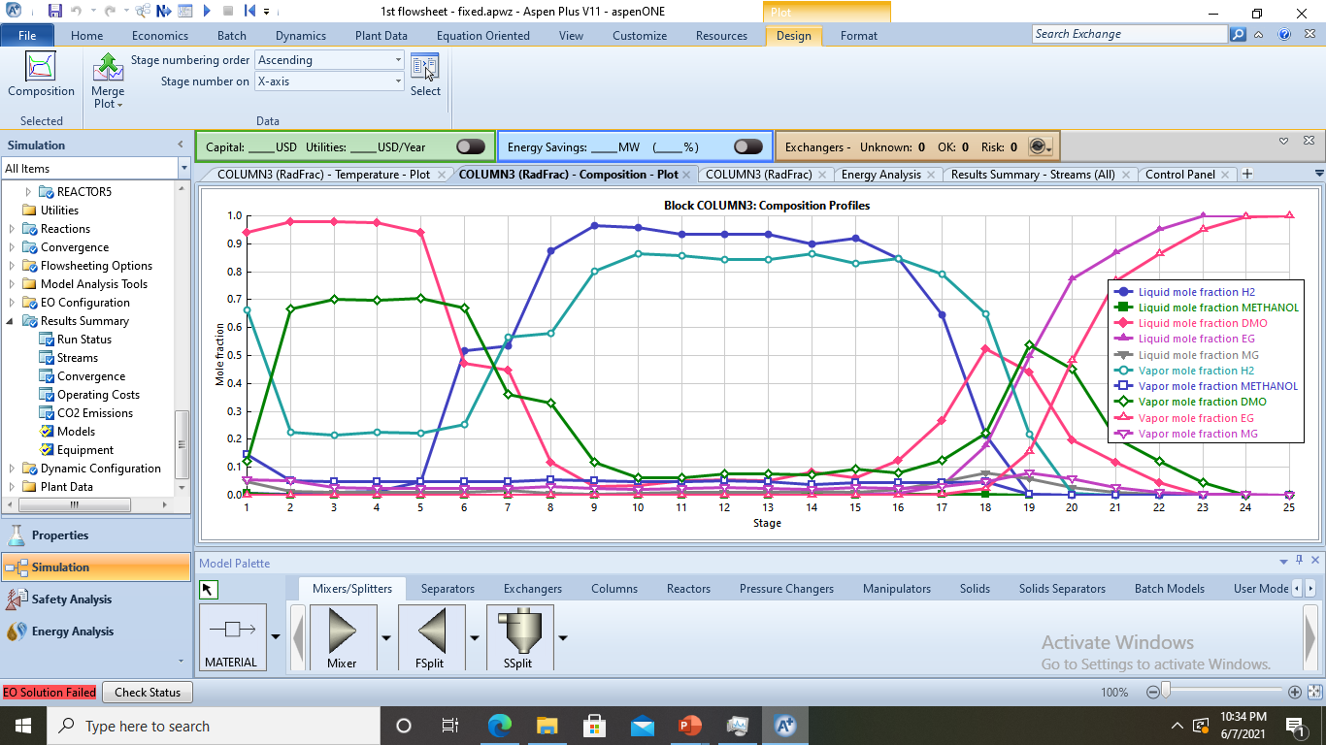
Separation 2: Getting EG
H2
NO
CH3OH
MG
DMO
EG
This is hard to separate
Flowsheet 1
Interest compound
193.45℃, 1 bar
7571.91 kg/hr
5.19w% H2
55.68w% DMO
18.21w% MeOH
19.36w% MG
0.02w% EG
1.27 w% NO
feed
NTS: 25
(feed stream: 18)
RR (mole): 2
205.23℃, 1 bar
830 kg/hr
100w% EG
Reb duty: 7.06 MW
Cond duty: -7.47 MW

Slide 11
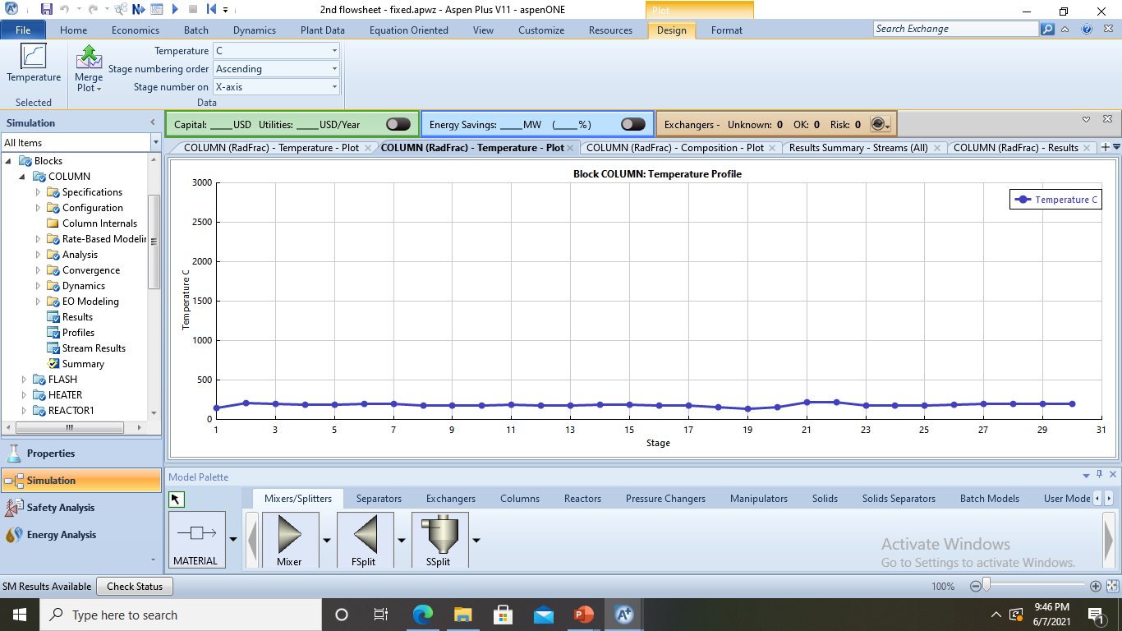
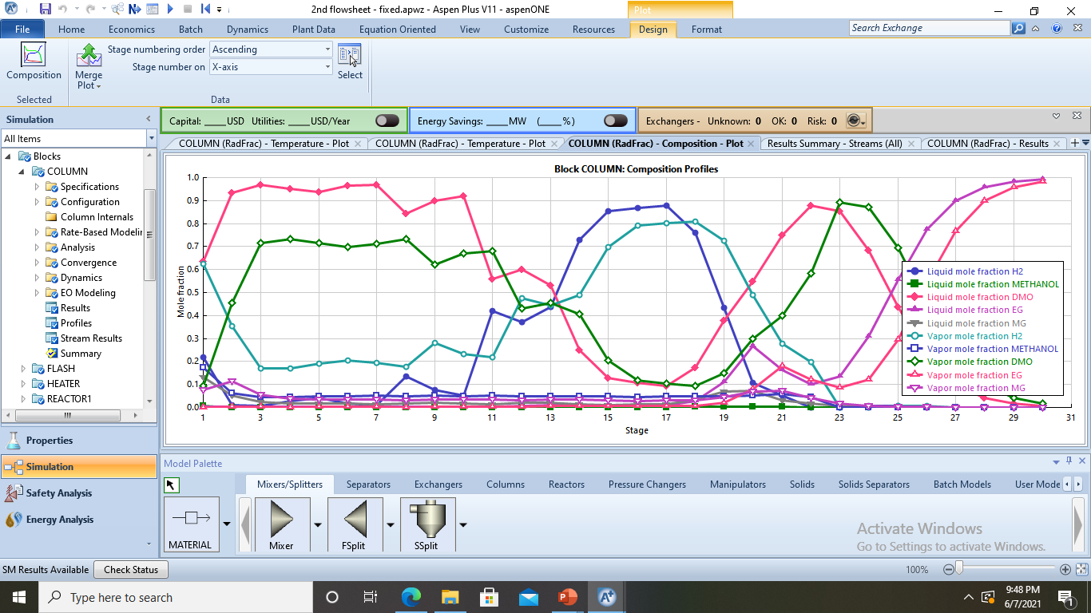
H2
NO
CH3OH
MG
DMO
EG
Separation 2: Getting EG
11
This is hard to separate
Flowsheet 2
Interest compound
feed
142.904℃, 1 bar
7490.2 kg/hr
4.93w% H2
42.85w% DMO
21.56w% MeOH
25.49w% MG
0.17w% EG
3.98w% NO
NTS: 30
(feed stream: 22)
RR (mole): 2
199.1℃, 1 bar
880 kg/hr
99w% EG
Reb duty: 11.63 MW
Cond duty: -12.28 MW

Slide 12
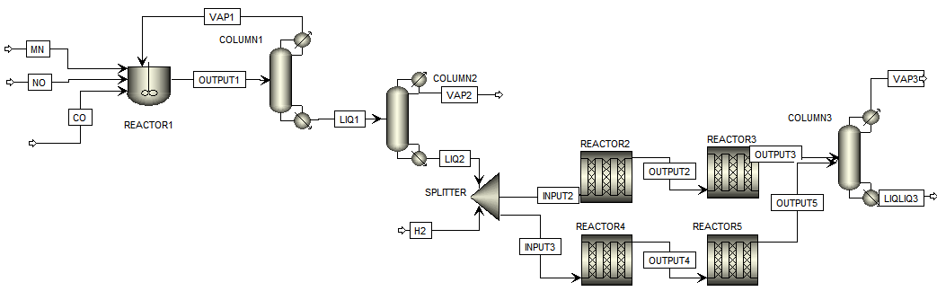
Aspen Simulation Flowsheet 1
193.45℃, 1 bar
7571.91 kg/hr
5.19w% H2
55.68w% DMO
18.21w% MeOH
19.36w% MG
0.02w% EG
1.27 w% NO
-174.3℃, 5 bar
16294.5 kg/hr
100w% CO
8000 kg/hr MN
1000 kg/hr NO
6000 kg/hr CO
Reb duty: 2.08 MW
Cond duty: 1.24 MW
-157.49℃, 5 bar
15000.02 kg/hr
51.46w% DMO
15.59w% CO
32.82w% NO
0.14w% MN
NTS: 21
(feed stream: 16)
RR (mole): 0.45
-182.59℃, 1 bar
7164.68 kg/hr
32.64w% CO
67.36w% NO
-858.92 kW
200℃, 16 bar
6 m, 100 tubes,
D: 0.02 m, 14 kg cat
-415.15 kW
241℃, 24 bar
6 m, 500 tubes,
D: 0.02 m, 923 kg cat
129℃, 5 bar
31294.5 kg/hr
24.66w% DMO
59.54w% CO
15.73w% NO
0.07w% MN
137.513℃, 1 bar
7835.55 kg/hr
98.51w% DMO
0.26w% MN
1.23w% NO
129℃, 5 bar
4710.65 kW
1597.86 L
Reb duty: -6.03 MW
Cond duty: -4.17 MW
NTS: 25 (feed stream: 18)
RR (mole): 2
NTS: 16
(feed stream: 4)
RR (mole): 5
Split fraction (mole): 0.5
H2 566.46 kg/hr
205.23℃, 1 bar
830 kg/hr
100w% EG
241℃, 24 bar
4201 kg/hr
4.68w% H2
50.18w% DMO
16.41w% MeOH
17.45w% MG
9.89w% EG
Reb duty: 7.06 MW
Cond duty: -7.47 MW
102.31℃, 1 bar
4201 kg/hr
6.74w% H2
91.87w% DMO
1.15w% NO
200℃, 16 bar
4201 kg/hr
6.71w% H2
90.98w% DMO
0.24w% MeOH
0.68w% MG

Slide 13
Aspen Simulation Flowsheet 2
85℃, 1.15 bar
4192.18 kg/hr
7.92w% DMO
0.58w% CO
90.21w% NO
1.29w% MN
129℃, 5 bar
11990 kg/hr
65.31w% DMO
0.21w% CO
34.02w% NO
0.46w% MN
142.904℃, 1 bar
7490.2 kg/hr
4.93w% H2
42.85w% DMO
21.56w% MeOH
25.49w% MG
0.17w% EG
3.98w% NO
25℃, 1 bar
8150 kg/hr
-755.05 kW
200℃, 16 bar
6 m, 100 tubes, 0.02 m diameter, 14 kg catalyst
-750.69 kW
244℃, 26 bar
6 m, 500 tubes, 0.02 m diameter, 923 kg catalyst
-200.79 kW
vapor fraction (mole): 0.64
25℃, 1 bar
100 kg/hr
-16119.2 kW
NTS: 30
(feed stream: 22)
RR (mole): 2
129℃, 5 bar
12635.2 kW
254.38 L
85℃, 1.15 bar
7797.82 kg/hr
96.16w% DMO
0.01w% CO
3.82w% NO
Split fraction (mole): 0.5
25℃, 5.17 bar
3740 kg/hr
199.1℃, 1 bar
880 kg/hr
99w% EG
20℃, 25.5 bar
572.51 kg/hr
244℃, 26 bar
4185.16 kg/hr
4.41w% H2
38.5w% DMO
19.29w% MeOH
23.70w% MG
10.52w% EG
Reb duty: 11.63 MW
Cond duty: -12.28 MW
81.71℃, 1.15 bar
4185.16 kg/hr
6.84w% H2
89.58w% DMO
3.56w% NO
200℃, 16 bar
4185.16 kg/hr
6.81w% H2
88.69w% DMO
0.24w% MeOH
0.68w% MG

Slide 14
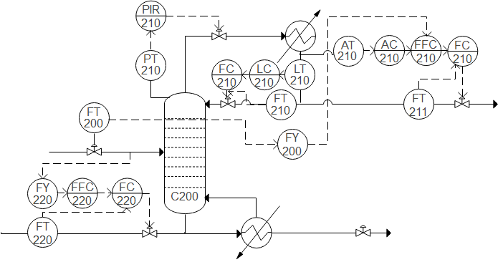
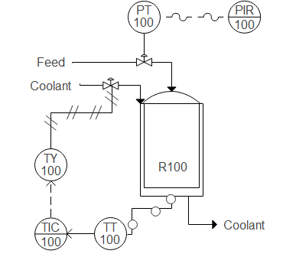
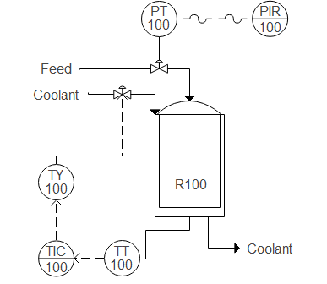
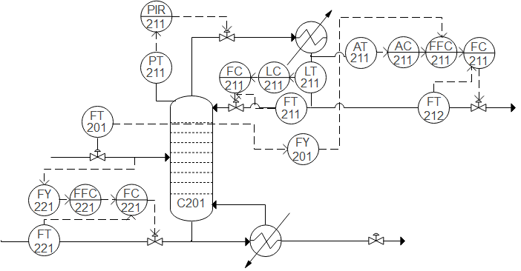
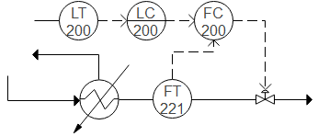
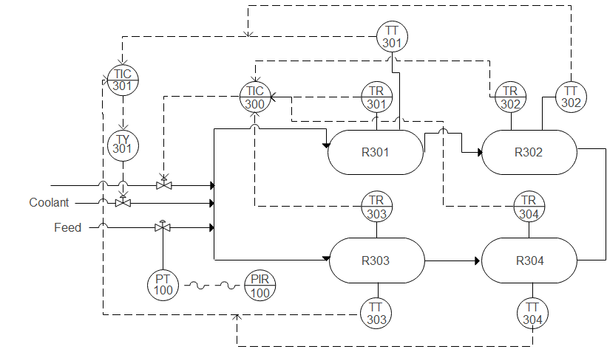

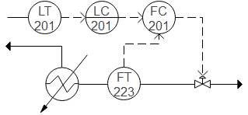
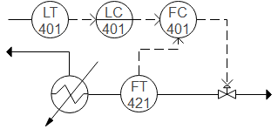
P&ID Diagram Flowsheet 2
Steam
Steam
Steam
222
Coolant
Steam

Slide 15
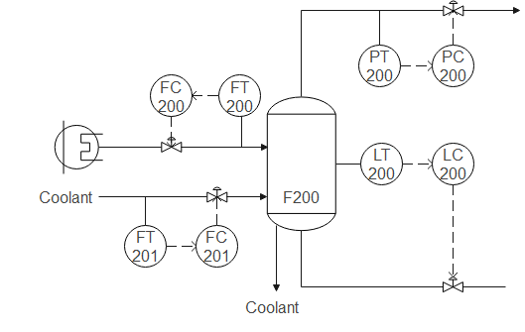
P&ID Diagram Flowsheet 2
Steam
Steam

Slide 16
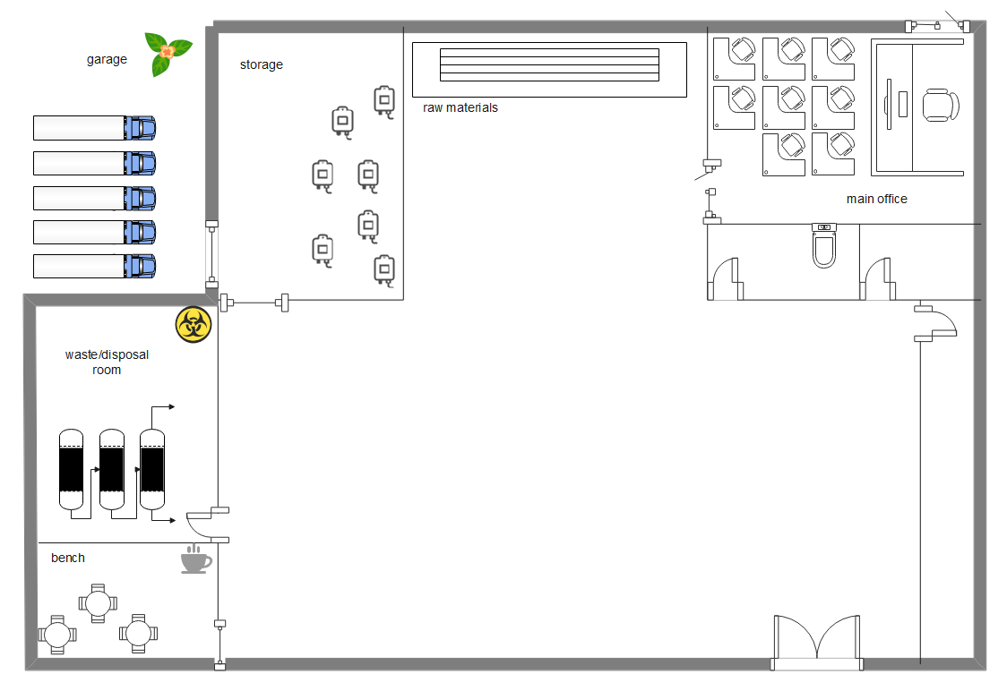
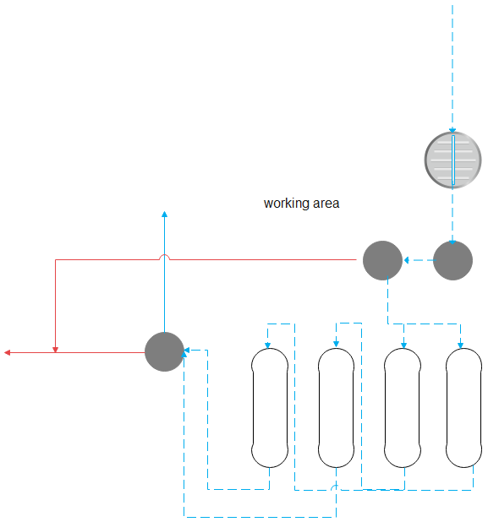

Floor Plan
35 m
3552
52 m

Slide 17




Economic Analysist

Slide 18
Review Previous Presentation
Economic Potential: $6276.29
 | Flowsheet 1 | Flowsheet 2
Raw Material Cost | $16,749,675 | $4,508,443
Revenue | $674,300,000 | $652,100,000
Catalyst Cost | $673,466
Total reactor purchase | $101,336
Total reactor installment | $142,081
Total Distillation Column Instalment | $400,183 | $112,581
Total Tray Instalment | $46,412 | $94,285
Total Reboiler instalment | $1,157,010 | $760,622
Total Condenser instalment | $136,429 | $107,906
Flash tank instalment | - | $107,906
Total Utility Cost | $13,247,673 | $24,734,910

Slide 19
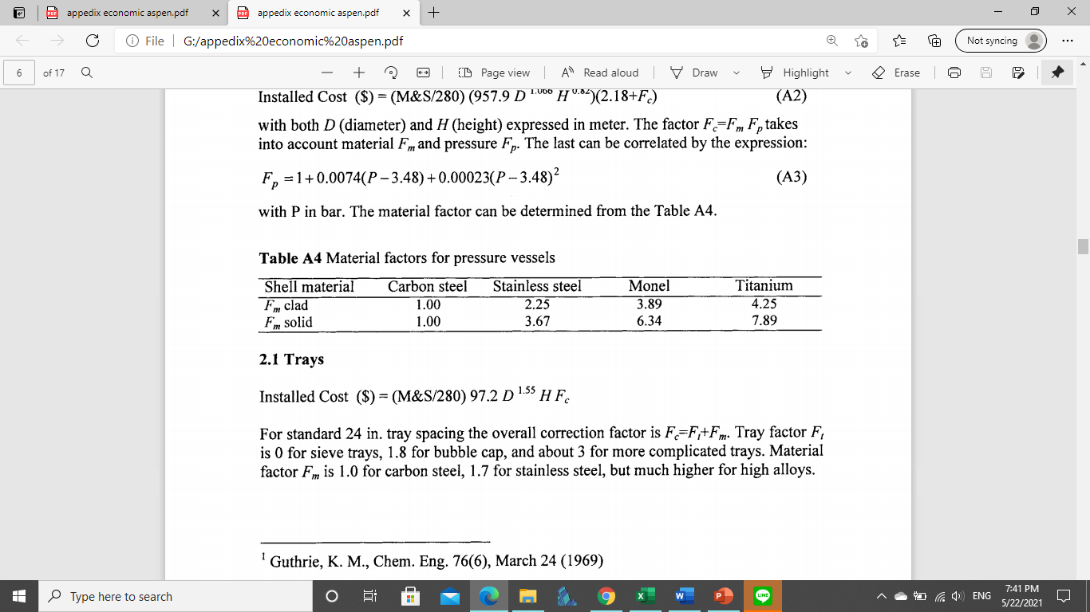
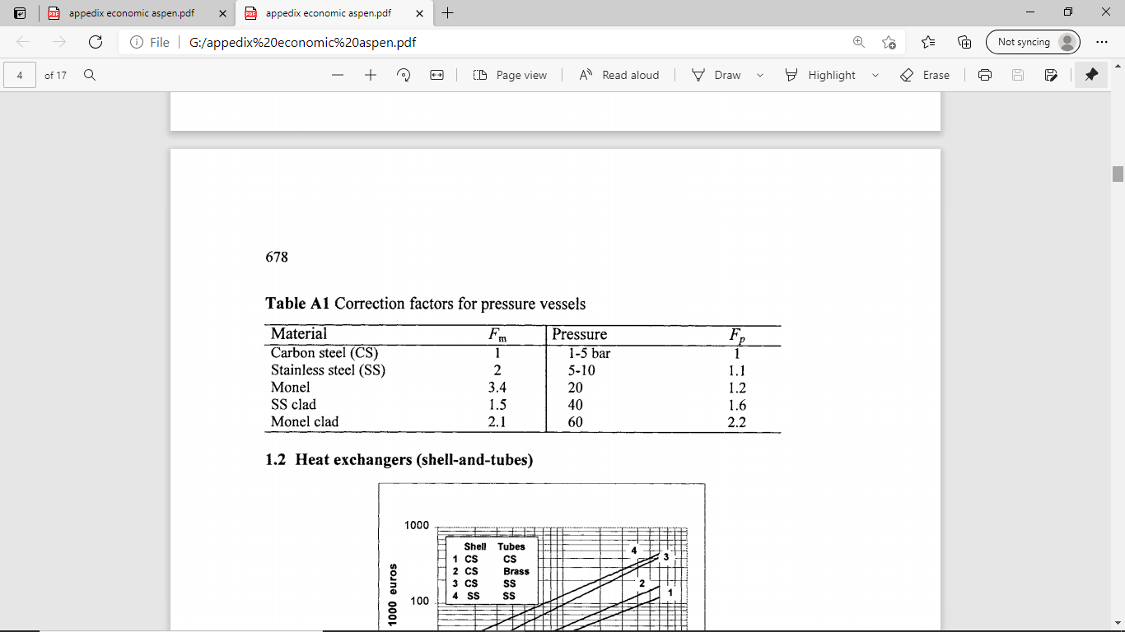
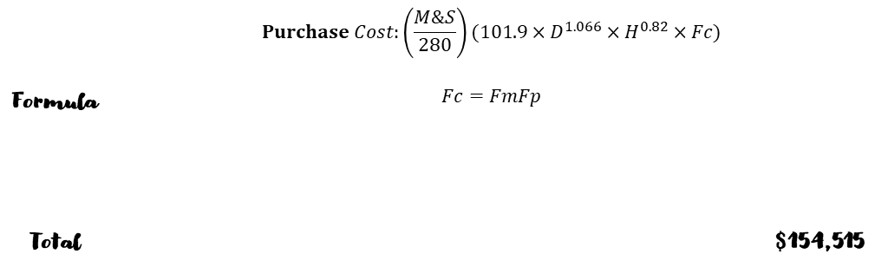
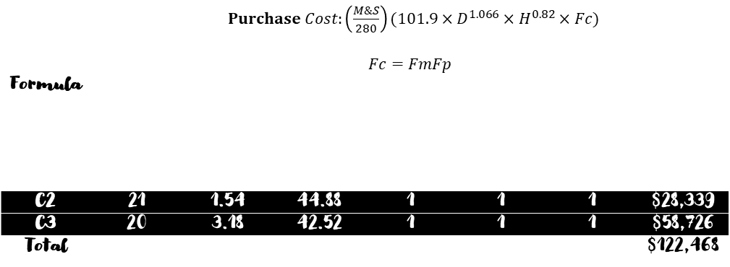
Distillation Column Cost – Flowsheet 1&2
Formula | $Purchase Cost:\left(\frac{M\&S}{280}\right)(101.9×D^{1.066}×H^{0.82}×Fc)$ $$Fc=FmFp$$
 | Specification |  |  |  |  |  | Installed Cost
 | No of Stages | Diameter (ft) | Height (ft) | Fm | Fp | Fc
C1 | 16 | 2.4 | 33.07 | 1 | 1 | 1 | $35,403
C2 | 21 | 1.54 | 44.88 | 1 | 1 | 1 | $28,339
C3 | 20 | 3.18 | 42.52 | 1 | 1 | 1 | $58,726
Total |  |  |  |  |  |  | $122,468
Formula | $$Purchase Cost:\left(\frac{M\&S}{280}\right)(101.9×D^{1.066}×H^{0.82}×Fc)$$ $$Fc=FmFp$$
 | Specification |  |  |  |  |  | Installed Cost
 | No of Stages | Diameter (ft) | Height (ft) | Fm | Fp | Fc
C1 | 30 | 5.61 | 66.14 | 1 | 1 | 1 | $154,515
Total |  |  |  |  |  |  | $154,515
Marshall and Swift (2020): 2171.6
Cost reference: Table A4 from James M. Douglas. (1988). Conceptual Design of Chemical Processes. McGraw-Hill Book Company.

Slide 20
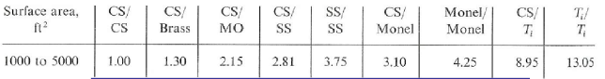
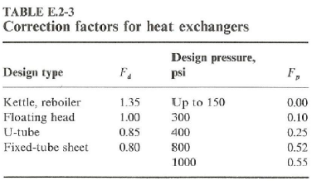
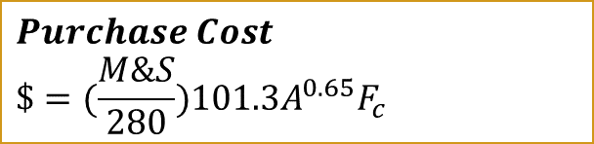
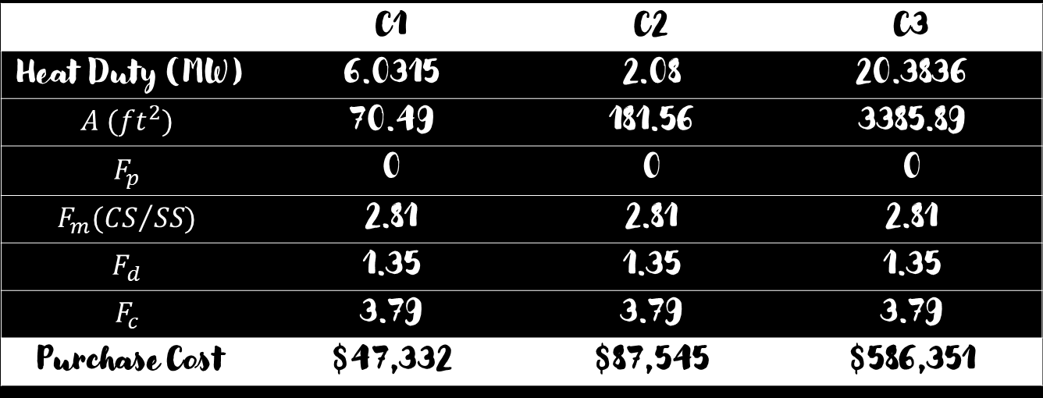
Reboiler Cost Flowsheet 1
$$Purchase Cost$$
$$\$=(\frac{M\&S}{280})101.3A^{0.65}F_{c}$$
 | C1 | C2 | C3
Heat Duty (MW) | 6.0315 | 2.08 | 20.3836
$$A ({ft}^{2})$$ | 70.49 | 181.56 | 3385.89
$$F_{p}$$ | 0 | 0 | 0
$$F_{m}({CS}/{SS)}$$ | 2.81 | 2.81 | 2.81
$$F_{d}$$ | 1.35 | 1.35 | 1.35
$$F_{c}$$ | 3.79 | 3.79 | 3.79
Purchase Cost | $47,332 | $87,545 | $586,351
Marshall and Swift (2020): 2171.6
Fc = (Fd + Fp) Fm
Total Purchase Cost: $721,228
Cost reference: Table A4 from James M. Douglas. (1988). Conceptual Design of Chemical Processes. McGraw-Hill Book Company.

Slide 21
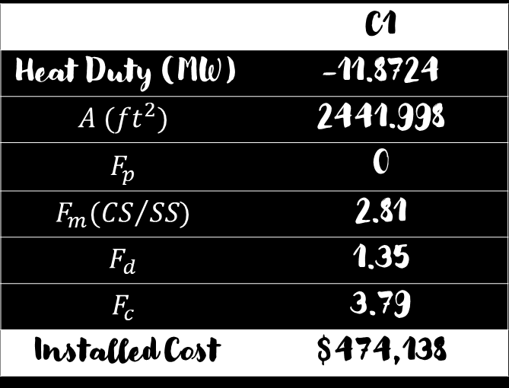
Reboiler Cost Flowsheet 2
$$Purchase Cost$$
$$\$=(\frac{M\&S}{280})101.3A^{0.65}F_{c}$$
 | C1
Heat Duty (MW) | -11.8724
$$A ({ft}^{2})$$ | 2441.998
$$F_{p}$$ | 0
$$F_{m}({CS}/{SS)}$$ | 2.81
$$F_{d}$$ | 1.35
$$F_{c}$$ | 3.79
Installed Cost | $474,138
Marshall and Swift (2020): 2171.6
Fc = (Fd + Fp) Fm
Cost reference: Table A4 from James M. Douglas. (1988). Conceptual Design of Chemical Processes. McGraw-Hill Book Company.

Slide 22
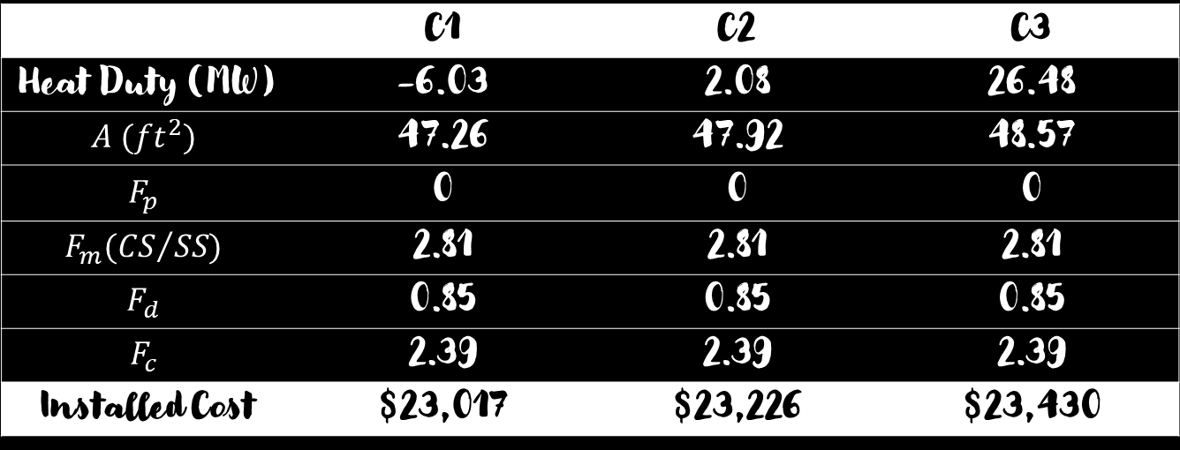
Condenser Cost Flowsheet 1
$$Purchase Cost$$
$$\$=(\frac{M\&S}{280})101.3A^{0.65}F_{c}$$
 | C1 | C2 | C3
Heat Duty (MW) | -6.03 | 2.08 | 26.48
$$A ({ft}^{2})$$ | 47.26 | 47.92 | 48.57
$$F_{p}$$ | 0 | 0 | 0
$$F_{m}({CS}/{SS)}$$ | 2.81 | 2.81 | 2.81
$$F_{d}$$ | 0.85 | 0.85 | 0.85
$$F_{c}$$ | 2.39 | 2.39 | 2.39
Installed Cost | $23,017 | $23,226 | $23,430
Marshall and Swift (2020): 2171.6
Fc = (Fd + Fp) Fm
Total Purchase Cost: $69,673
Cost reference: Table A4 from James M. Douglas. (1988). Conceptual Design of Chemical Processes. McGraw-Hill Book Company.

Slide 23
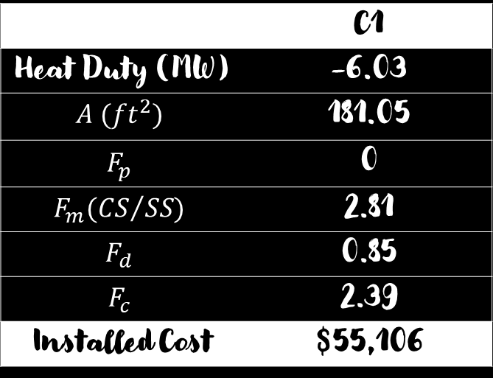
Condenser Cost Flowsheet 2
$$Purchase Cost$$
$$\$=(\frac{M\&S}{280})101.3A^{0.65}F_{c}$$
 | C1
Heat Duty (MW) | -6.03
$$A ({ft}^{2})$$ | 181.05
$$F_{p}$$ | 0
$$F_{m}({CS}/{SS)}$$ | 2.81
$$F_{d}$$ | 0.85
$$F_{c}$$ | 2.39
Installed Cost | $55,106
Marshall and Swift (2020): 2171.6
Fc = (Fd + Fp) Fm
Cost reference: Table A4 from James M. Douglas. (1988). Conceptual Design of Chemical Processes. McGraw-Hill Book Company.

Slide 24
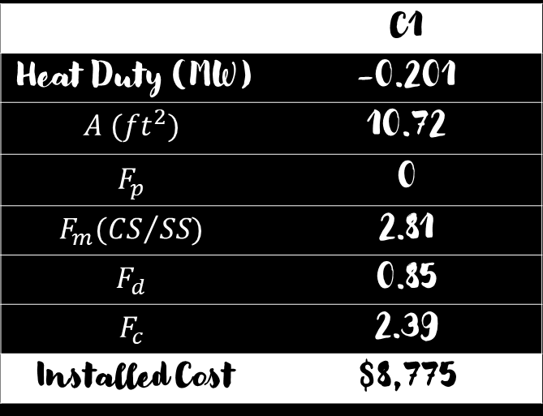
Flask Tank Cost Flowsheet 2
$$Purchase Cost$$
$$\$=(\frac{M\&S}{280})101.3A^{0.65}F_{c}$$
 | C1
Heat Duty (MW) | -0.201
$$A ({ft}^{2})$$ | 10.72
$$F_{p}$$ | 0
$$F_{m}({CS}/{SS)}$$ | 2.81
$$F_{d}$$ | 0.85
$$F_{c}$$ | 2.39
Installed Cost | $8,775
Marshall and Swift (2020): 2171.6
Fc = (Fd + Fp) Fm
Cost reference: Table A4 from James M. Douglas. (1988). Conceptual Design of Chemical Processes. McGraw-Hill Book Company.

Slide 25
Utility costs-1st flowsheet
Equipment | Utility | Parameter
 |  | Price | Amount (gal/yr or lb/yr) | Cost (USD/year)
Column 1 | Cooling water | (USD/gal) | 62,946,852
Column 2 |  |  | 11,758,291
Column 3 |  |  | 78,431,682
Reactor 2,4 |  |  | 32,186,236
Reactor 3,5 |  |  | 2,804,702
Column 2 | Steam | (USD/lb) | 865,740,563
Column 3 |  |  | 2,352,767,663
Reactor 1 |  | (USD/lb) | 3,197,858,400
Pump | Electricity
Total: USD/yr
Total:
USD/yr
Cost reference: Table E.1-1 from James M. Douglas. (1988). Conceptual Design of Chemical Processes. McGraw-Hill Book Company. Assume T cooling water=15℃ at 1 bar (other operational pressure will be accustomed according to Thermodynamic T-S diagram), Cp=4.2 kJ/K.mol (water) and 1.87 kJ/K.mol (steam)

Slide 26
Utility costs-2nd flowsheet
Equipment | Utility | Parameter
 |  | Price | Amount (gal/yr or lb/yr) | Cost (USD/year)
Flash 1 | Cooling water | (USD/gal) | 102,022,395
Cooler |  |  | 907,883
Column |  |  | 179,887,802
Reactor 2,4 |  |  | 28,293,924
Reactor 3,5 |  |  | 5,004,460
Column | Steam | (USD/lb) | 1,832,366,268
Reactor 1 |  | (USD/lb) | 8,577,495,772
Pump | Electricity
Total: USD/yr
Total:
USD/yr
Cost reference: Table E.1-1 from James M. Douglas. (1988). Conceptual Design of Chemical Processes. McGraw-Hill Book Company. Assume T cooling water=15℃ at 1 bar (other operational pressure will be accustomed according to Thermodynamic T-S diagram), Cp=4.2 kJ/K.mol (water) and 1.87 kJ/K.mol (steam)

Slide 27


Labor Cost
N_{OL} = $4.5{×(6.29+31.7P^{2}+0.23N_{np})}^{0.5}$
N_{OL}: # of operator per shift
P: # of particulate solids handling
N_{np}: # of non-particulate solids of handling
P = 1
$N_{np}$ = 3
N_{OL} = $4.5{×(6.29+31.7{\left(1\right)}^{2}+0.23(3))}^{0.5}$
N_{OL} = 30 operators
Minimum monthly wage:
NT 35,000/person 1 month salary = $1,268 / person
1 year wage:
$14,582 x 30 = $437,460/year

Slide 28


Total Calculation
$/Year | Flowsheet 1 | Flowsheet 2
Purchase Cost | $1,014,705 | $793,870
Installed Cost | $1,882,115 | $1,325,381
Utilities | $13,247,673 | $24,734,910
Onsite Cost | $16,144,493 | $26,854,161
Offsite Cost | $48,433,479 | $80,562,483
Start-up Cost | $8,072,247 | $13,427,081
Working Capital | $5,715,151 | $9,506,373
Fixed Capital Investment | $80,722,465 | $134,270,805
Total Capital Investment | $38,101,004 | $63,375,819
Offsite Cost = $3 \left(Onsite costs\right)$
Start-up costs = 0.1 FCI
Working capital = 0.15 TCI
Fixed capital investment = $1.25 \left(Onsite costs+Offsite costs\right)$
Total capital investment$=2.36 \left(Onsite costs\right)$

Slide 29

Profitability Calculation
$/Year | Flowsheet 1 | Flowsheet 2
Revenue | $674,300,000 | $652,100,000
Total Production Cost | $57,000,972 | $61,184,836
Gross profit before tax | $617,299,028 | $590,915,164
Depreciation | $2,922,153 | $4,860,603
Profit after tax | $509,932,806 | $486,425,286
Cash Flows | $512,924,959 | $491,285,889
Tax Taiwan: 17%
Revenue = $MMH Produced x Price of MMH$
Total production cost$=1.03 \left(Raw materials+ Utilities\right)+ 2.13× \left(Operating labor cost\right)+ 0.103 \left(Fixed Capital Investment\right)+0.025 \left(Revenue\right)$
Gross Profit before taxes =$Revenue −Total Product Cost$
Depreciation = $0.181 \left(Onsite\right)$
Profit after taxes = ($1 −0.17) (profit before taxes −Depreciation)$
Cash flow $= Profit after taxes+Depriciation$

Slide 30



Return of Investment
Annual percent return on investment before taxes
r_{b} = $\frac{P x 100}{I}$
Annual percent return on investment after taxes
r_{a} = $\frac{E x 100}{I}$
 | Flowsheet 1 | Flowsheet 2
r_{b} | 1620 | 932.4
r_{a} | 1338.4 | 767.53
Pay Out Time
Pay Out Time (year) = $\frac{Fixed Capital Cost+Start−up Cost}{Cash Flow}$
Flowsheet 1 | 0.1731
Flowsheet 2 | 0.3

Slide 31
DCFROR (Discounted Cash Flow Rate of Return)

Slide 32
 | Flowsheet 1 |  | Flowsheet 2
 | i= | 0.876665 | i= | 0.691084
 | Investment | Discount Factor | Investment | Discount Factor
Year 4 | 8,072,247 | 12.4036 | 13,427,081 | 8.1783
Year 3 | 32,288,986 | 6.6094 | 53,708,322 | 4.8361
Year 2 | 32,288,986 | 3.5219 | 53,708,322 | 2.8598
Year 1 | 8,072,247 | 1.8767 | 13,427,081 | 1.6911
Working Capital | 5,715,151 | 1 | 9,506,373 | 1
Start-Up Cost | 8,072,247 | 1 | 13,427,081 | 1
PV Investment |  | 456,188,661 |  | 568,782,044
 | Cash Flow |  | Cash Flow
Year 1 | 307,712,975 | 0.5329 | 294,771,533 | 0.5913
Year 2 | 461,569,463 | 0.2839 | 442,157,300 | 0.3497
Year 3 | 487,212,211 | 0.1513 | 466,721,595 | 0.2068
Year 4 | 512,854,959 | 0.0806 | 491,285,889 | 0.1222
Year 5 | 512,854,959 | 0.043 | 491,285,889 | 0.0723
Year 6 | 512,854,959 | 0.0229 | 491,285,889 | 0.0428
Year 7 | 512,854,959 | 0.0122 | 491,285,889 | 0.0253
Year 8 | 512,854,959 | 0.0065 | 491,285,889 | 0.0149
Year 9 | 512,854,959 | 0.0035 | 491,285,889 | 0.0088
Year 10 | 512,854,959 | 0.0018 | 491,285,889 | 0.0052
Working Capital | 5,715,151 | 0.0018 | 9,506,373 | 0.0052
Salvage Value | 2,421,674 | 0.0018 | 4,028,124 | 0.0052
PV Return |  | 456,188,661 |  | 568,781,081

Slide 33
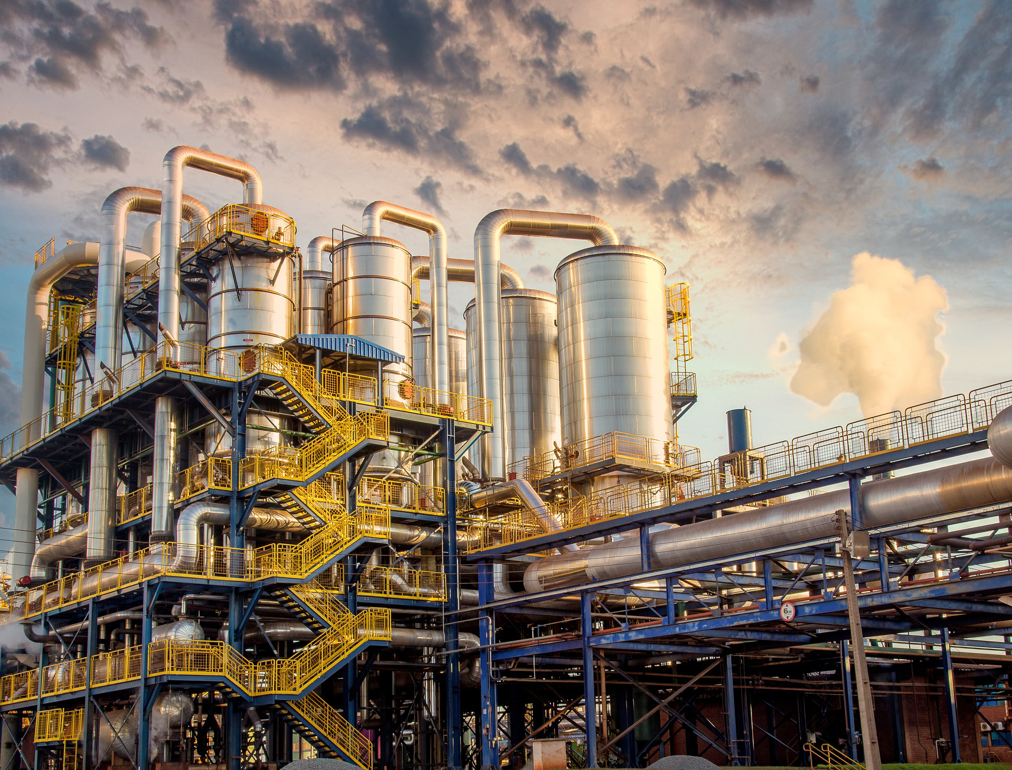
Conclusion

Slide 34
Comparison of Design 1 & 2
Design Point of View
 | Flowsheet 1 | Flowsheet 2
Reactor Volume | 1597.86 L (CSTR) | 254.38 L (CSTR)
 | 4586.98 (PFRs) | 4586.98 (PFRs)
Distillation Tower | Column 1: 16 stages | 30 stages
 | Column 2: 21 stages
 | Column 3: 25 stages
EG produced (ton/yr) | 6,872,400 (100 w%) | 7,286,400 (99w%)
Economic Point of View
 | Flowsheet 1 | Flowsheet 2
Total Capital Investment | $38,101,004 | $63,375,819
Total Production Cost | $57,000,972 | $61,184,836
ROI (rb,ra) | 1620, 1338.4 | 932.4, 767.53
Payout Time | 0.1731 | 0.3
DCFROR | 87.67% | 69.11%

Slide 35
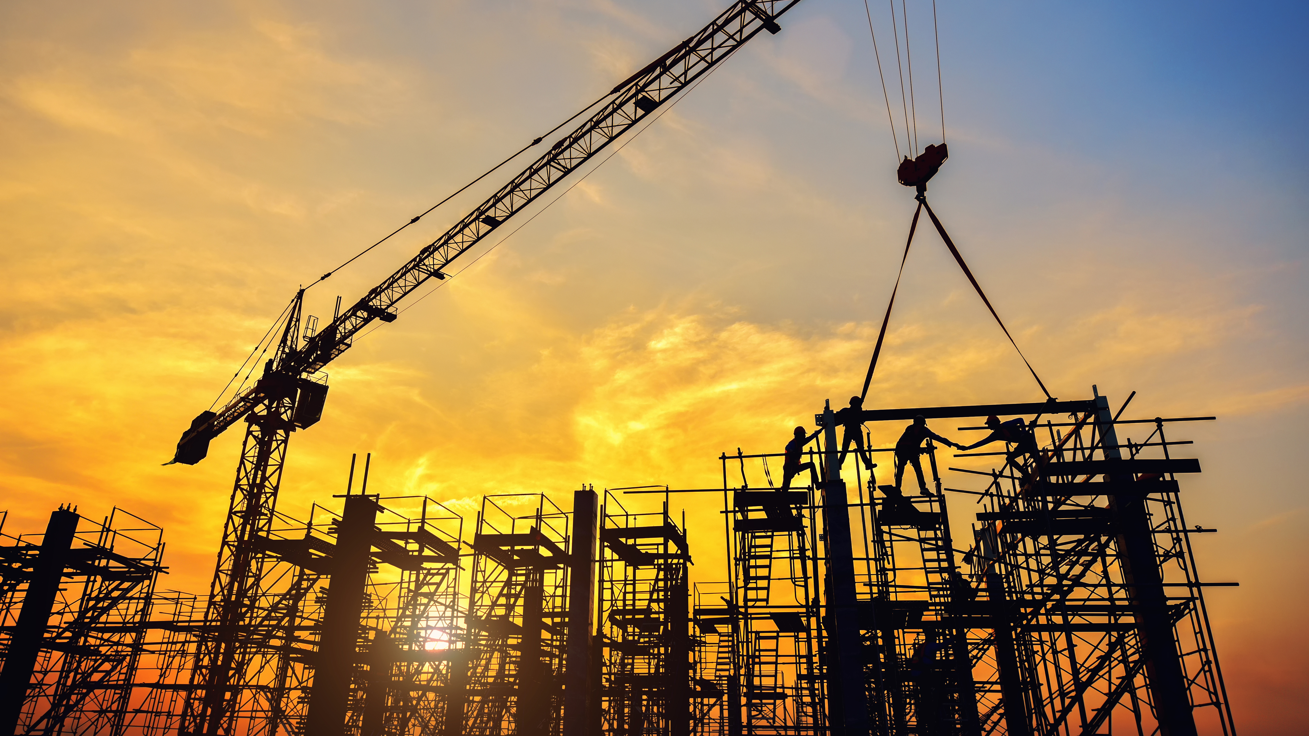
Thank you

